Slide 1
Counselor – Machine Learning Recommender System for Educational Institutions
Muhammad Abdul Nafay (19P-0117)
Sheheryaar Ali (19P-0120)
Saad Javed(19P-0111)
Supervisor: Shoaib Muhammad Khan

Slide 2
Introduction
Full Stack web application which recommends Educational Institutes using machine learning algorithms according to user’s preferences and Interests
Input include user’s:
Academic Profile
Location
Interest
Budget etc.

Slide 3
Literature Review

Slide 4
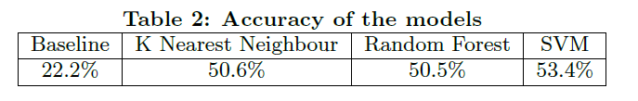
Paper #01 University Recommender System for Graduate Studies in USA
Basic Idea: Recommendation of University based on students profiles with Admits/Rejects criteria to 45 different universities in USA
Methodologies:
Scrapping of Data of 45 different universities along with data transformation
Used Support Vector Machine, K-Nearest Neighbors and Random Forest
Result Evaluation:
Limitations:
This project doesn’t take students interests, budget & location into consideration while recommending universities.
Takes only 45 universities from 1047 total universities in India.

Slide 5
Paper #02 Analysis and Design of Personalized Recommendation System for University Physical Education (P.E)
Basic Idea: Idea of college student’s demands for P.E classes, and recommendation of an exercise is given according to the user’s physicality/fitness.
Methodologies:
Input Module (Collection of user Information along with their preferences)
Personalized Processing Module (Recommendation Process using CF)
Output Module (Displays various types of course programs recommended to the users)
Result Evaluation: Conceptually Valid, Actual Implementation not done.
Limitations:
No two-way Interaction with the system through students' giving feedback.
Uses just Featured Based Collaborative Filtering (FBCF) with Pearson correlation algorithm.

Slide 6
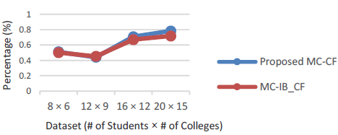
Paper #03 An Approach to a University Recommendation by MC-CF and Dimensionality Reduction Techniques
Basic Idea: Uses MC-CF and Dimensionality Reduction technique to provide high quality University/College recommendation.
Methodologies:
Uses Multi Criteria Collaborative Filtering
Applied HOSVD with PCA along with cosine-based similarity for evaluation.
Result Evaluation:
Limitations:
Affordability & the location of the institute itself isn’t taken into consideration

Slide 7
Paper #04 Developing and Evaluating a University Recommender System
Basic Idea: This paper builds a university recommender system, eliciting user preferences as ratings to build predictive models & generate personalized university ranking lists.
Methodologies:
A LAMP Stack Application which used SVD & KNN Algorithm to recommend different university list
Result Evaluation:
The presented results in the offline and online studies seemed promising. The SVD algorithm was most appropriate, based on accuracy, perceived personalization, and satisfactory result.
Limitations:
This paper uses convenience sample as a way for collecting data.
This focuses on gaining information from participants who are 'convenient' for the researcher to access.
This method will have reduced the quality of the collected data (samples are often biased).

Slide 8
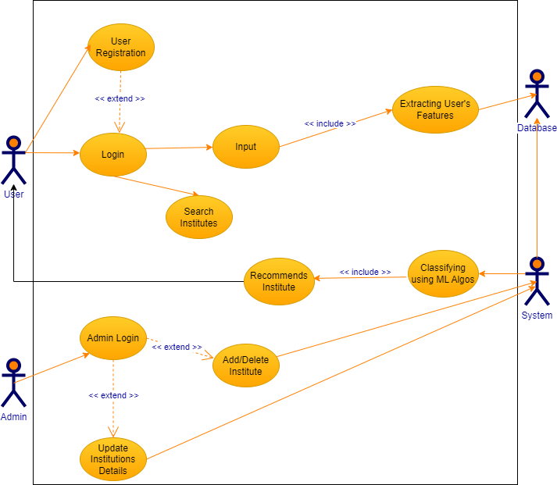
Use Case Diagram

Slide 9



Internet
Client Application
Controller
Model
HTTP Request
View
HTTP Response
Spring MVC Framework
Recommendations
Users Request
Child_Process.spawn()
Top-N Recommendation
Machine Learning Algorithms
Pymongo
Raw Data
Data Transformation
Recommendation Engine

Slide 10
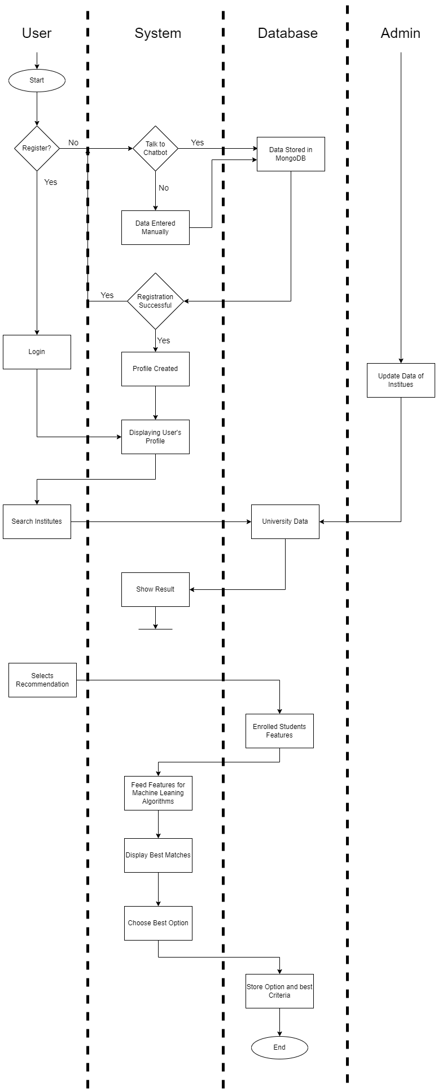
Swimlane Diagram

Slide 11
Swimlane Diagram (cont..)

Slide 12

NoSQL Database
Non-tabular databases
Document databases
Stores data in JSON
Each document contains pairs of fields and values.

Slide 13
Data Representation
User | Object_id
_id | Object_id
U_Name | String
Email | String
Password | String
Location | String
Budget | Int
Interest | String
Transcript_id | Object_id
Transcript | Object_id
_id | Object_id
Percentage | Float
Group | String
Program | Object_id
_id | Object_id
Fees | Int
SSC_Criteria | Int
HSSC_Criteria | Int
SATI_Criteria | Int
SATII_Criteria | int
Institutions | Object_id
_id | Object_id
I_Name | String
Province | String
Scholarship | Boolean
Hostel Accomodation | Boolean
Program_id | Object_id

Slide 14
Methodologies
Data Pre-processing.
Ensemble Learning.
Neighborhood Algorithms.
Decision Trees
Recommendation stored in database.
Retrieved by custom made GET API.
Displayed in REACT Application for the end user.

Slide 15
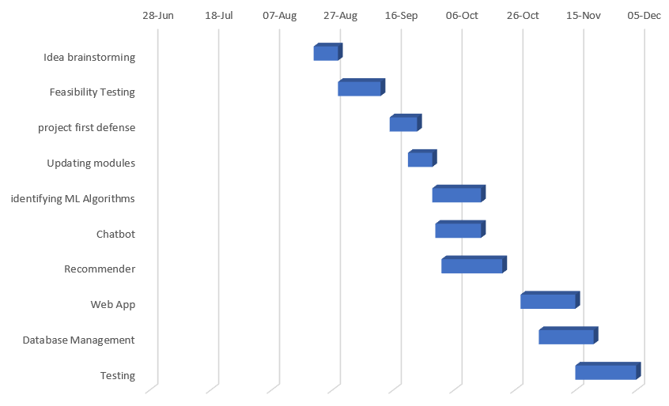
Timeline

Slide 16
Distribution of Work
Abdul Nafay
Sheheryar Ali
Saad Javed
Data Collection.
Data Processing.
Frontend & Backend of Web Application.
Machine Learning Algorithms.
Documentation.
Chatbot
Image Processing
Machine Learning Algorithms.
Documentation.
Frontend & Backend of Web Application.
Machine Learning Algorithms.
Documentation.

Slide 17
References
https://cseweb.ucsd.edu/classes/wi15/cse255-a/reports/fa15/026.pdf
https://www.researchgate.net/publication/301476042_An_Approach_to_a_University_Recommendation_by_Multi-criteria_Collaborative_Filtering_and_Dimensionality_Reduction_Techniques
https://www.frontiersin.org/articles/10.3389/frai.2021.796268/full
https://sci-hub.hkvisa.net/10.1109/icnds.2010.5479470

